Slide 1


Introduction to Data
Gabriel Avelino Sampedro, Ph.D.
Chairman, Korean Institute of Communications and Information Sciences - PH Section
Founder / CEO, Philippine Coding Camp

Slide 2

DATA
Scientists seek to answer questions using rigorous methods and careful observation. These observations – collected from the likes of field notes, surveys, and experiments – form the backbone of a statistical investigation and are called data.
OpenIntro Statistics

Slide 3
DATA
Data refers to pieces of facts and statistics collected and recorded for the purposes of analysis.
Data is all around us
A collection of related pieces of data is sometimes referred to as a dataset.

Slide 4

Examples of Data

Slide 5
Examples of Data

Slide 6
Examples of Data

Slide 7
Examples of Data

Slide 8
Examples of Data

Slide 9
Examples of Data

Slide 10
Examples of Data

Slide 11
Examples of Data

Slide 12
Examples of Data

Slide 13

Examples of Data

Slide 14
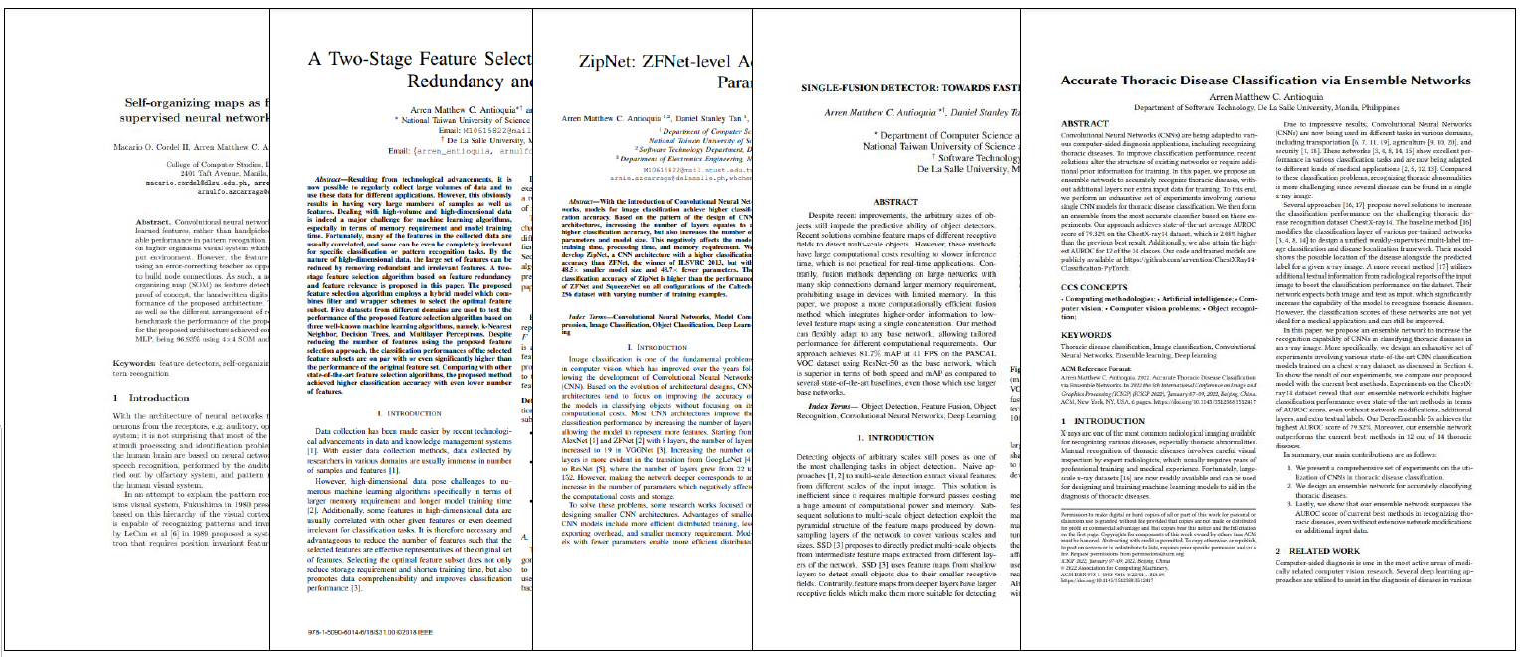
Examples of Data

Slide 15
Examples of Data

Slide 16

Types of Data

Slide 17

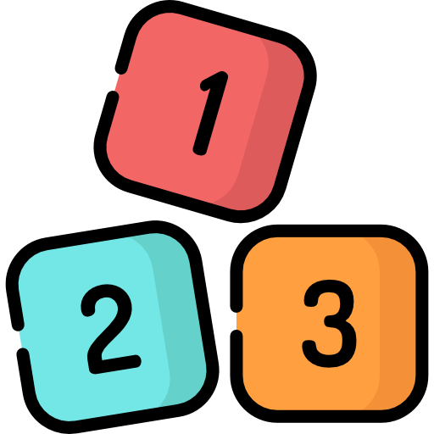
TYPES OF DATA
Categorical Data
Descriptive information may take on
several distinct categories
Numerical Data
Numerical information that can be
objectively measured

Slide 18
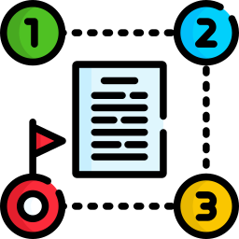
TYPES OF DATA
Ordinal Data
Have a sense of ordering
Nominal Data
No sense of ordering

Slide 19


TYPES OF DATA
Discrete Data
Can take on specific value
Continuous Data
Can take on any value within a range

Slide 20
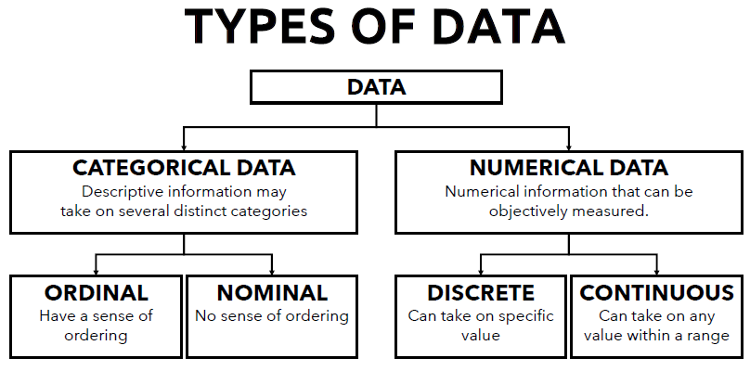
TYPES OF DATA

Slide 21

Forms of Data

Slide 22

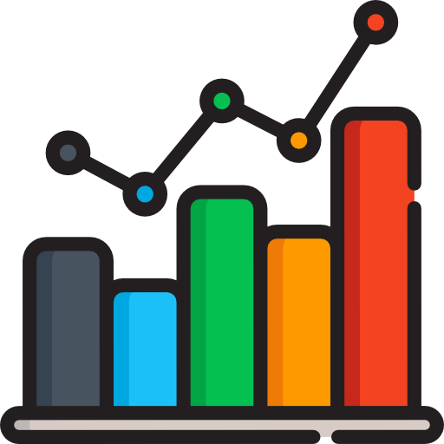




FORMS OF DATA
Structured
Unstructured
Graph-based
Language
Audio & Video
Generated

Slide 23
FORMS OF DATA
Structured Data
Adheres to some structured model

Slide 24

FORMS OF DATA
Unstructured Data
Does not adhere to a standardized format

Slide 25
FORMS OF DATA
Graph-based Data
Represented as pairwise relationships between objects

Slide 26
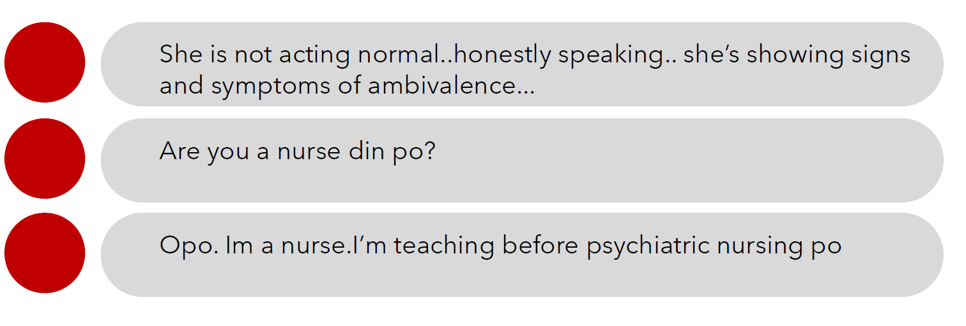
FORMS OF DATA
Natural Language
Information expressed in human language

Slide 27
FORMS OF DATA
Audio and Video Data
Not represented in text format

Slide 28
FORMS OF DATA
Generated Data
Recorded by applications without human intervention

Slide 29

Data Collection

Slide 30
DATA COLLECTION
Data collected and recorded by other people
Public online sources – data made public over the internet
Private sources – contacting people or organizations to request for data

Slide 31


DATA COLLECTION
Data collected by YOU
Observational Study
Data where no treatment has been
explicitly applied
Experiment
Data collected from studies where
treatments are assigned to cases

Slide 32
DATA COLLECTION
Observational Study
Researchers perform an observational study when they collect data in a way that does not interfere with how the data arise.
Example: Cell data taken from a sample of patients infected with COVID-19.

Slide 33
DATA COLLECTION
Experiment
Researchers perform an experiment by applying treatment to an experimental group and comparing it against an untreated control group.
Example: Cell data from 2 groups of COVID-19 patients, one given medicine and one given placebo treatment.

Slide 34
DATA COLLECTION
In an observational study, only correlation, or relationship between variables can be concluded.
An experiment is needed for causation to be established, by isolating all other variables aside from the one being treated.
Causation ≠ Correlation

Slide 35

DATA COLLECTION
Data may be collected not for any specific research question or purpose, but just collected for future potential analysis.
Example: website interaction logs

Slide 36

DATA COLLECTION
Data could already exist somewhere in the world, waiting to be collected for some research goal or purpose.
Example: scraping movie reviews
from Metacritic

Slide 37

Sampling

Slide 38

SAMPLING
Population refers to the entire group of elements to which
you intend to generalize your data on.

Slide 39
SAMPLING
In an ideal world, data should be collected from the whole population.
However, often it is not possible.

Slide 40

SAMPLING
Instead, a sample is collected to represent the entire population.
If the sample is selected properly, then the findings can be generalized to the entire population.

Slide 41
SAMPLING
In general, the sample should be chosen randomly to avoid bias, where the sample is skewed towards certain groups and does not represent the whole group.

Slide 42
SAMPLING
SAMPLING BIAS
Convenience Bias – Only the data that is easy to collect is included in the sample.
Nonresponse Bias – Some chosen participants for the sample are unwilling to give data
Voluntary Response Bias – Only people who are willing to volunteer are included in the sample.
Exclusion Bias – Some groups of people are deliberately excluded to participate in the data collection.

Slide 43
SAMPLING
Simple Random Sampling
Randomly select observations from the population.

Slide 44
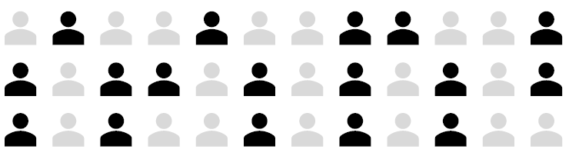
SAMPLING
Stratified Random Sampling
Randomly select observations from the population

Slide 45
SAMPLING
Stratified Random Sampling
Suppose there is a population, and the sample size is 12.

Slide 46
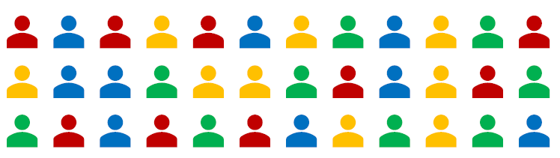
SAMPLING
Stratified Random Sampling
Arrange the population according to some meaningful groupings or strata.

Slide 47
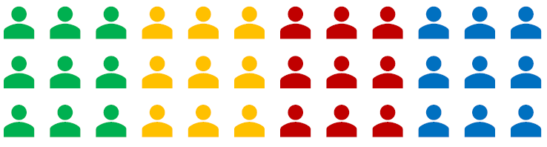
SAMPLING
Stratified Random Sampling
In this example, the population is grouped according to their university,
as imposed by the research.

Slide 48
SAMPLING
Stratified Random Sampling
Members in a stratum are homogeneous and members of a
stratum are heterogenous from members of another stratum.

Slide 49
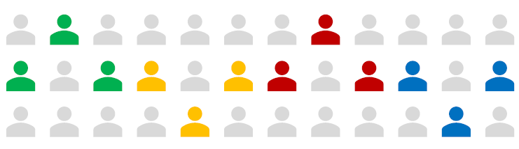
SAMPLING
Stratified Random Sampling
Then, randomly sample from each group to get a sample of 12.

Slide 50
SAMPLING
Cluster Sampling
Suppose there is a population, and the sample size is 12.

Slide 51
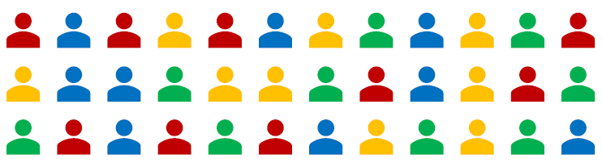
SAMPLING
Cluster Sampling
Cluster sampling divides the population
into natural groups, i.e., address, age, sex.

Slide 52
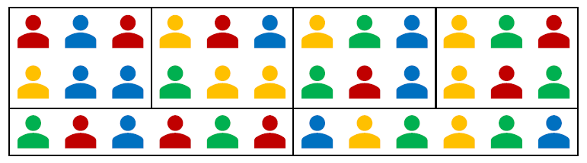
SAMPLING
Multistage Sampling
In this example, the population is grouped
according to their address.

Slide 53
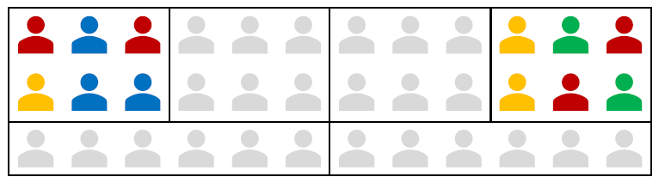
SAMPLING
Multistage Sampling
Choose clusters
to include in the sample.

Slide 54
SAMPLING
Multistage Sampling
Suppose there is a population, and the sample size is 12.

Slide 55
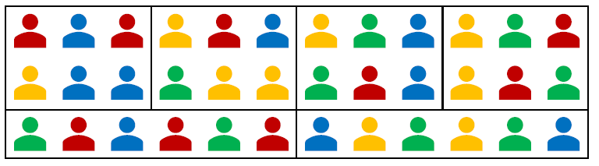
SAMPLING
Multistage Sampling
Multistage sampling extends cluster sampling where the
population is clustered into natural groups.

Slide 56
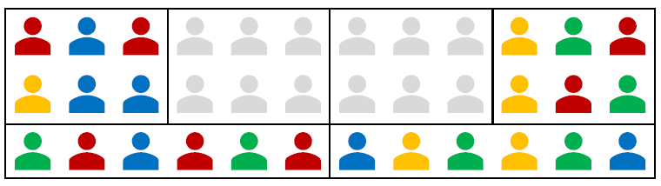
SAMPLING
Multistage Sampling
Stage 1: Select clusters to be included in the sample.

Slide 57
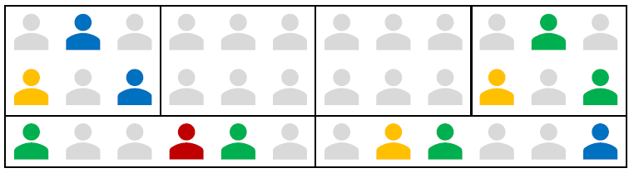
SAMPLING
Multistage Sampling
Stage 2: Randomly sample from the selected clusters.

Slide 58
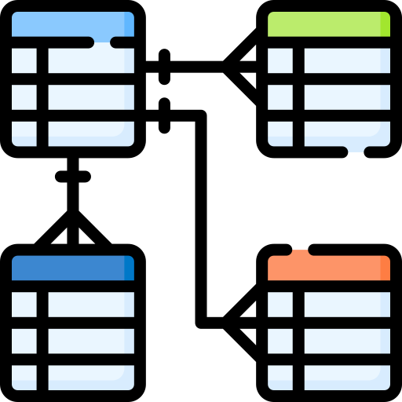
Data Modelling

Slide 59
DATA MODELLING
In order to make use of data, some preprocessing steps must be performed on it.
This process is motivated by an overarching research question or goal.

Slide 60

DATA MODELLING
Raw Real-World
Data
This is the raw data that exists all around us.

Slide 61


DATA MODELLING
Computer Representation of Data
Raw Real-World
Data
Load this data on some representation that the computer can
understand and process.

Slide 62
DATA MODELLING
Computer Representation of Data
Raw Real-World
Data
Mathematical
Model
Estimate or represent this data using a systematic mathematical model.

Slide 63

DATA MODELLING
Computer Representation of Data
Inference or Transformation or Insights
Raw Real-World
Data
Mathematical
Model
Make conclusions, transformations, or generate insights from the model.

Slide 64
DATA MODELLING
Modelling should be backed-up with a research question.
This may come in different forms:
Sometimes, it is a question out of curiosity.
But for projects, there is usually a well-defined research question that needs to be addressed.
This question drives every decision in the project.

Slide 65
DATA MODELLING
A good research question is:
Clear and Concise – It should be easy to understand, easy to explain to others, free of technical jargon.
Feasible – It could be answered using the available data and resources at your disposal.
Meaningful – It addresses a real problem, not something trivial or obvious.

Slide 66



DATA MODELLING
Some steps that are performed in answering research
questions and achieving research goal:
Data Preprocessing
Explanatory Data Analysis
Data Modelling

Slide 67
DATA MODELLING
Data Preprocessing
Real-world data is often ‘dirty.’
Incomplete – Some values might be missing
Noisy – May contain outliers or errors in measurement
Inconsistent – May contain discrepancies in encoding

Slide 68
DATA MODELLING
If the data is analyzed without preprocessing, it may result into low quality results.
Thus, some preprocessing steps are often done to ‘clean’ the data of these problems.
Other data preprocessing techniques may also be done, such as discretization or normalization, depending in the data.

Slide 69
DATA MODELLING
Exploratory Data Analysis
Build a general understanding of:
Relationship between different variables
Distribution of the different variables
Outliers in the data, if any
General characteristics of the data as a whole
Performing exploratory data analysis can sometimes help identify good research questions.

Slide 70
DATA MODELLING
Exploratory Data Analysis
In exploratory data analysis, data visualization
is often used to gain a better understanding of the data.

Slide 71
DATA MODELLING
Data modelling involves creating a mathematical approximation of the data.
A mathematical model represents your data in a systematic way, where mathematical techniques can be applied to make comparisons, transformations, and conclusions.

Slide 72
DATA MODELLING
Mathematical models allow us to:
Describe/summarize the data systematically.
Make comparisons systematically.
Make inferences supported with statistical confidence.
Statistical inference means drawing conclusions in the presence of uncertainty.

Slide 73
DATA MODELLING
In this workshop, we will go through the general process of:
Identifying a real-world dataset
Formulating some questions or goals for the data
Performing pre-processing
Performing exploratory data analysis
Approximating data using a mathematical model
Drawing conclusions / answering the research questions

Slide 74
Thank you for listening!
Let’s Connect: Gabriel Avelino Sampedro, Ph.D.
garsampedro@ieee.org
WhatsApp: +63 999 992 9515

